Slide 1

PHARMA SUPPLY CHAIN MONITORING USING BLOCKCHAIN AND IOT
YASH BHOSALE_18104049
JAINAM CHOPRA_18104064
SATISH GUPTA_18104024

Slide 2
Contents
Introduction
Problem Statement
Objectives
Scope
State Diagram/Workflow
Block Diagram
Technology Stack
Conclusion
References

Slide 3
1. Introduction
Problem Identified :
  There is a pressing need for product tracking and tracing owing to globalized supply chains, diverse suppliers, risk of counterfeit products, and customer demand for in-depth visibility.
Solution Proposed :
  Combining IoT and blockchain provides a mature way to digitally track and trace Pharma vaccines, medicines by fully integrating supply chain applications with core ERP applications.

Slide 4
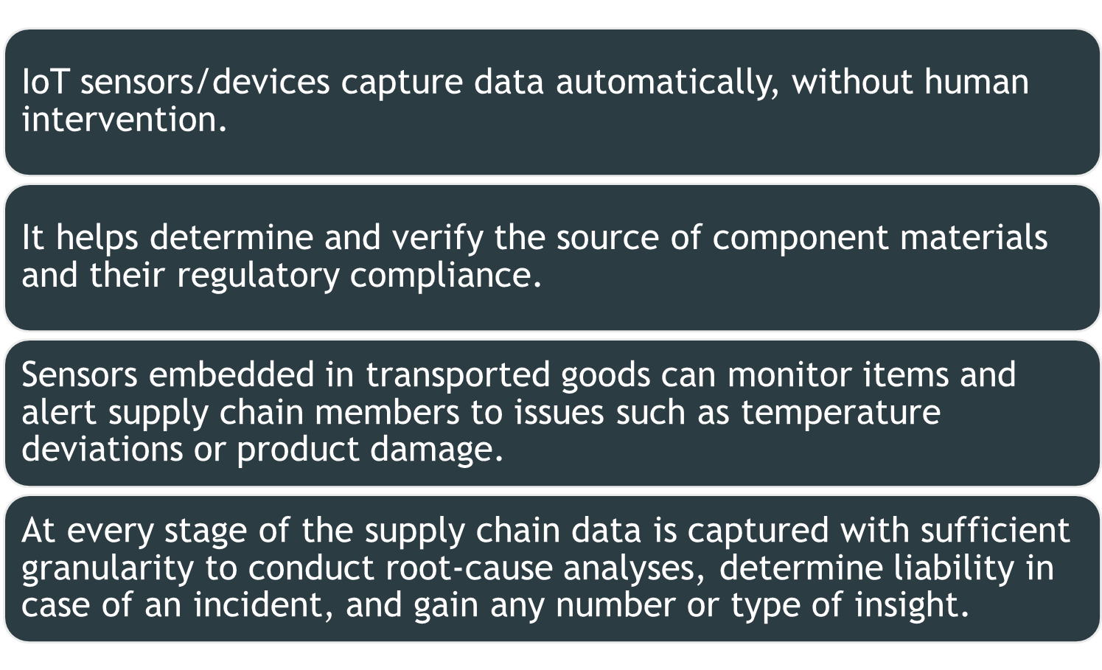
2. Problem Statement

Slide 5
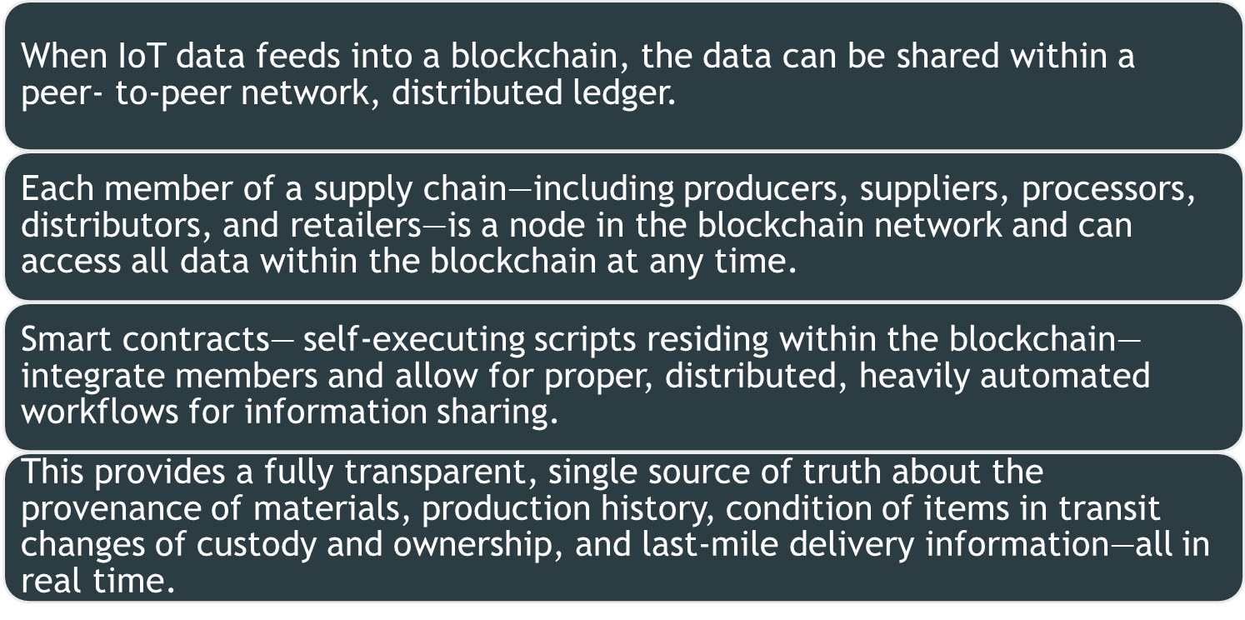
2. Problem Statement

Slide 6
3. Objectives
To design a supply chain traceability system that models manufacturing processes as token recipes.
2. To present a prototypical implementation for the Ethereum Virtual Machine (EVM) using smart contracts.
To make users or the members present in a blockchain aware about the whereabout’s and the conditions of vaccines, medicnes etc.
To provide a decentralized, immutable, and secure blockchain.

Slide 7
4. Scope
Can be used in pharma supply chain
Can be used in efficient management of vaccines.
Can be used in logistics management of medical pharmacy equipments including door to door delivery.
Can be used in manufacturing operations etc.

Slide 8
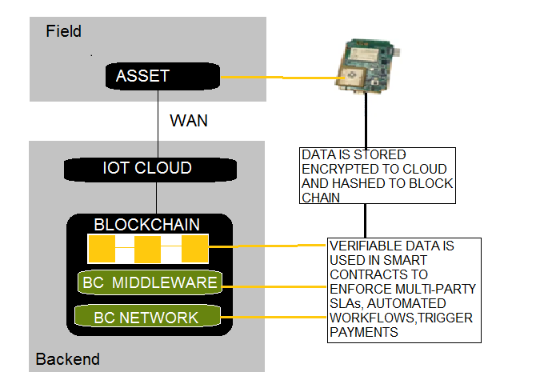
5. State Diagram/Workflow

Slide 9
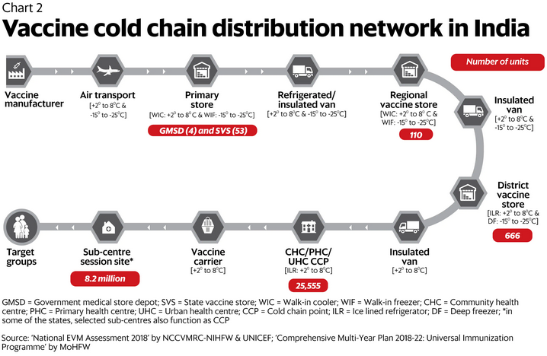
5. State Diagram/Workflow

Slide 10
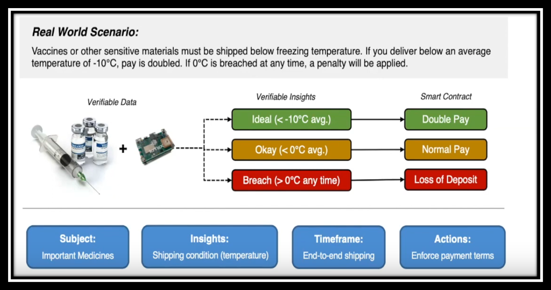
5. State Diagram/Workflow

Slide 11
State Diagram/Workflow
SUPPLY CHAIN OR THE MANUFACTURING PROCESS OF PFIZER
Task no | Details | Location
Step 1 | Manufacturing of plasmid DNA or template for mRNA vaccines | St. Louis
Step 2 | Manufacturing of drug substance | Andover, Massachusets
Step 3 | Combining the above substances and filling in vials | Kalamazoo, Michgan
Step 4 | Vials get packed and labelled
Step 5 | Moved to freezer farm Stored in crates which are installed with gps and temperature sensors
Components is step 1 and 2 are installed with temperature and other specific sensors—and the data is stored in the block under TOKEN RECIPE
Components in step 5 are the final products installed with gps, temperature sensors—and the data is stored in block under NFT.

Slide 12
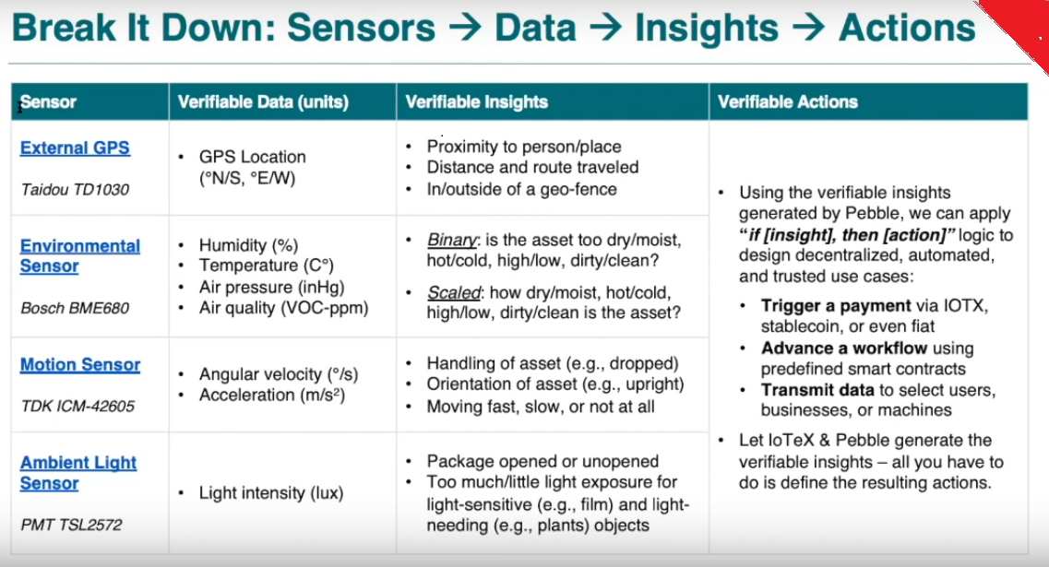

Slide 13
7. Hardware and Software Requirement
IOT Devices
  External Gps : Taidou TD 1030
  Environmental sensors : Bosch BME 680
  Light Sensors : PMT TSL 2752
  Motion Sensor : TDK ICM-42605
  Backend - Ethereum, Web3.js, Solidity, Truffle, Metamask
  Frontend - React.js, CSS, JavaScript
  Database - IPFS (Decentralised Storage)
  Server-Side Frameworks - Express.js

Slide 14
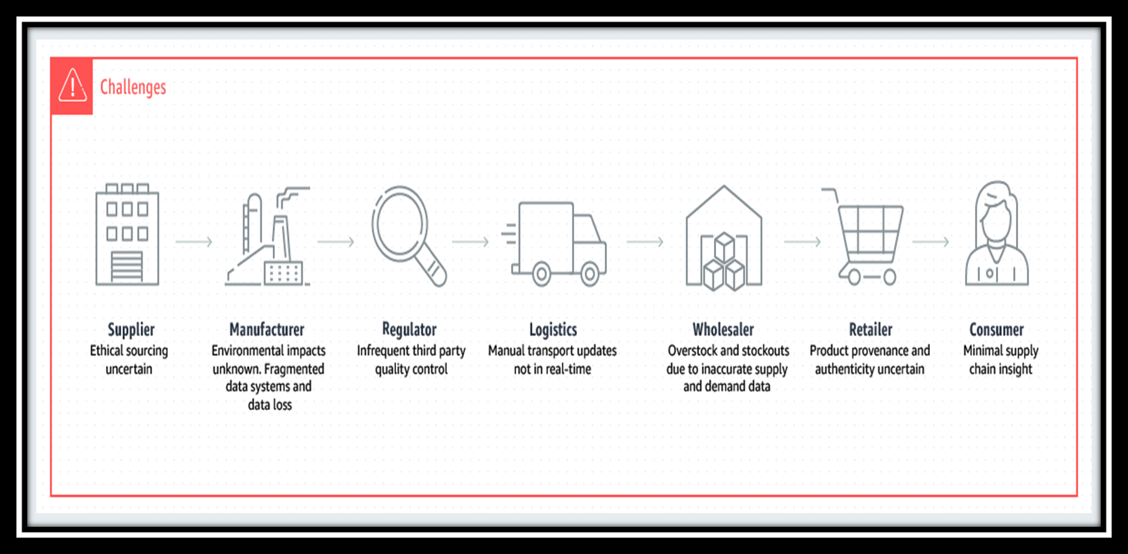
SUPPLY CHAIN WITH AND WITHOUT BLOCKCHAIN

Slide 15
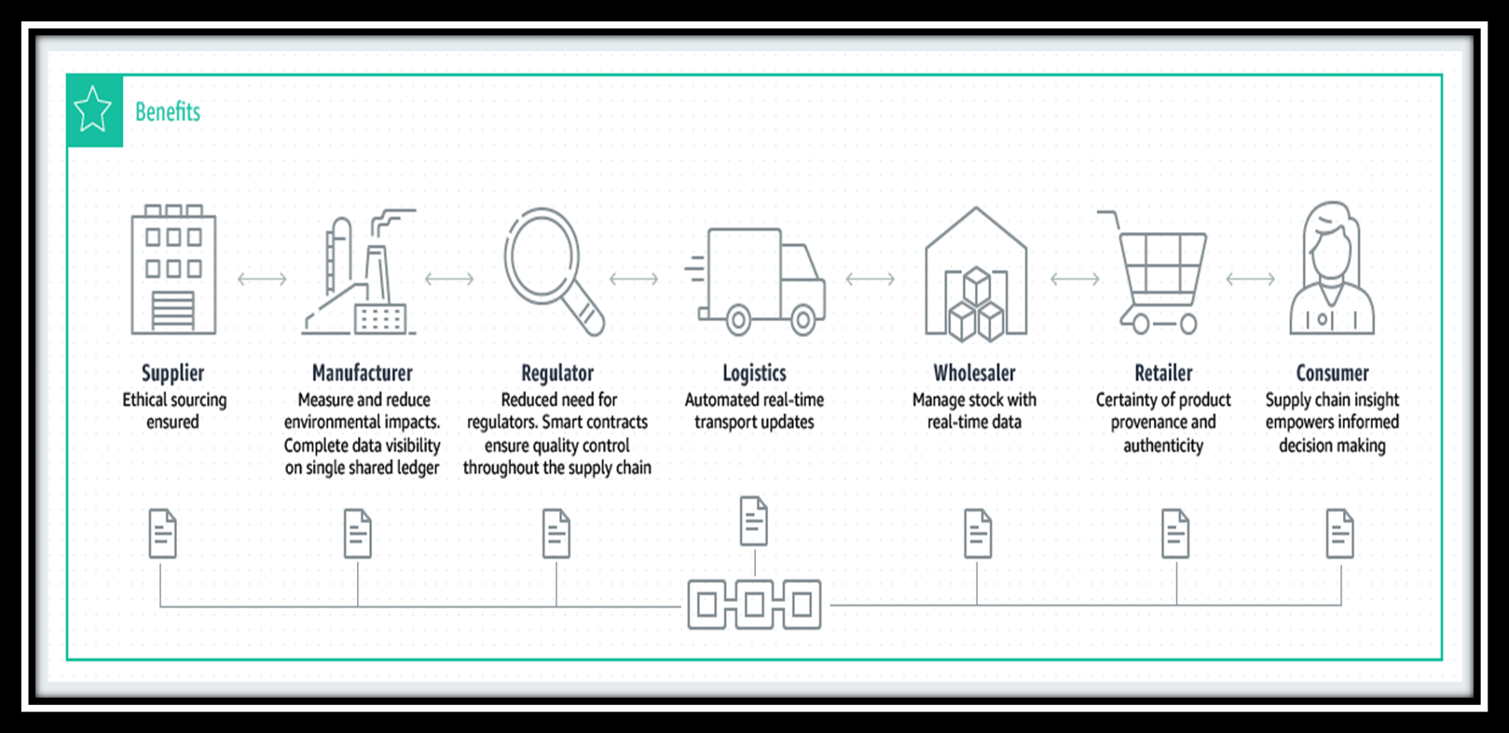

SUPPLY CHAIN WITH AND WITHOUT BLOCKCHAIN

Slide 16
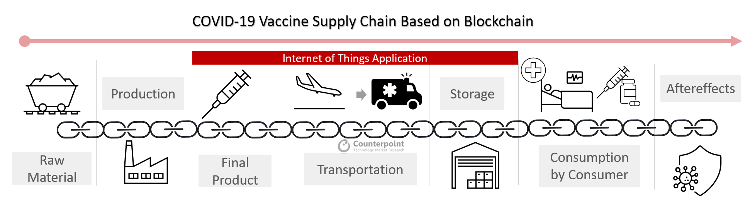

Slide 17
9. Conclusion
From a system perspective, the combination of blockchain and the Internet of Things is both reliable and impregnable while being comprehensive enough to accommodate all supply chain needs.
It offers a mature track and trace technical solution to improve compliance and assist with other tasks such as product recalls, returns, etc.
More importantly, it simplifies the process of searching for, acquiring, and gathering data across complex supply chains by using a distributed yet centralized system.

Slide 18
References
F. Dabbene, P. Gay, C. TortiaTraceability issues in food supply chain management: a review Biosyst. Eng., 120 (2014), pp. 65-80
J. Gualandris, R.D. Klassen, S. Vachon, M. Kalchschmidt Sustainable evaluation and verification in supply chains: aligning and leveraging accountability to stakeholders
https://ieeexplore.ieee.org/document/9118549
https://www.oracle.com/cloud/ blockchain/

Slide 19
Thank You...!!

